Slide 1

House Price Index
Q2 2025
31 July 2025

Slide 2

Updates
House Price Index – Q2 2025
This quarter we are introducing new analysis on the sale of rental properties using rental licencing data from the Health & Safety (Rented Dwellings) law. This data allows us to produce:
the number of properties sold in a quarter which held a rental licence before the date of sale
the net change in rental stock in a quarter due to property transactions

Slide 3
Summary
House Price Index – Q2 2025
In the second quarter of 2025:
on a rolling four-quarter basis, the mix-adjusted average price of dwellings sold in Jersey during the year ending Q2 2025 was essentially unchanged when compared with the previous quarter (year ending Q1 2025)
  14% lower than the peak in the index seen in Q3 2022
2- and 4-bedroom houses saw a decrease in their mean price compared to the previous quarter
all other property types were unchanged or saw an increase in price compared with the previous quarter
the turnover of properties was 8% higher than in Q2 2024 and 5% higher than in the previous quarter (Q1 2025)

Slide 4
Summary
House Price Index – Q2 2025
In the second quarter of 2025:
of the HPI eligible properties transacted this quarter, 38 were previously private rental properties and 25 were purchased to be private rental properties
  this results in a net change of -13 units of private rental accommodation (a decrease of around 0.1% in private rental accommodation)

Slide 5
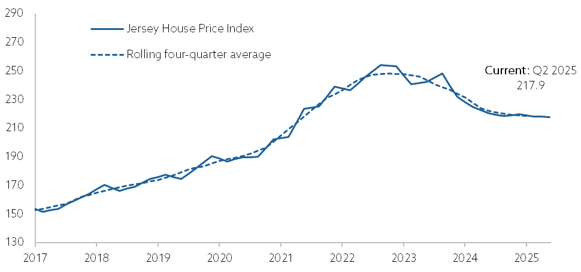
Mix-adjusted House Price Index
House Price Index – Q2 2025
Rolling four-quarter basis:
essentially unchanged when compared with the year ending Q1 2025
Seasonally adjusted quarterly basis:
1% lower when compared with previous quarter and a year earlier

Slide 6
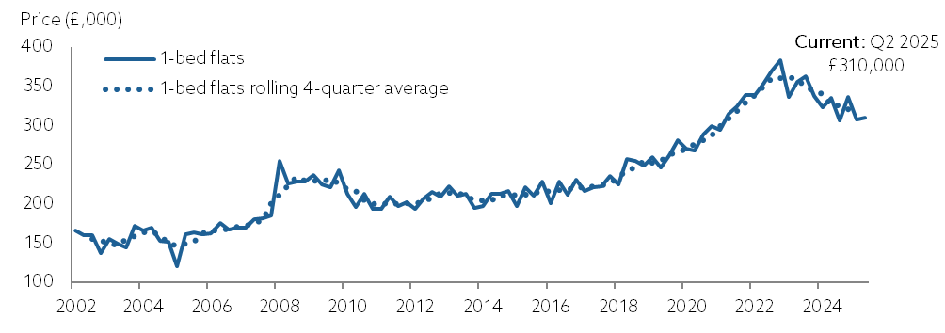
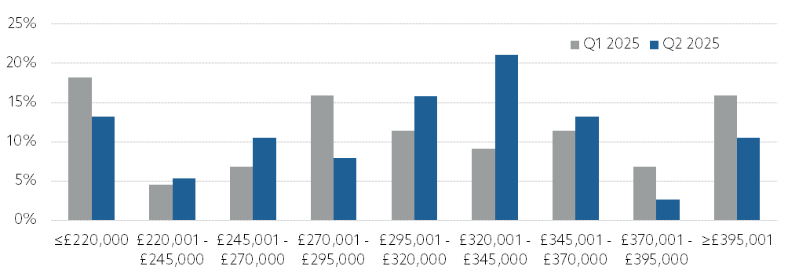
1-bedroom flats
House Price Index – Q2 2025
mean price of £310,000
2,000 higher than previous quarter
median price of £313,000

Slide 7
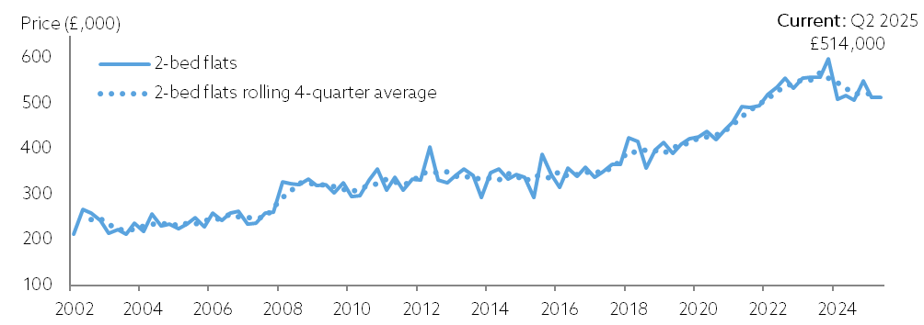
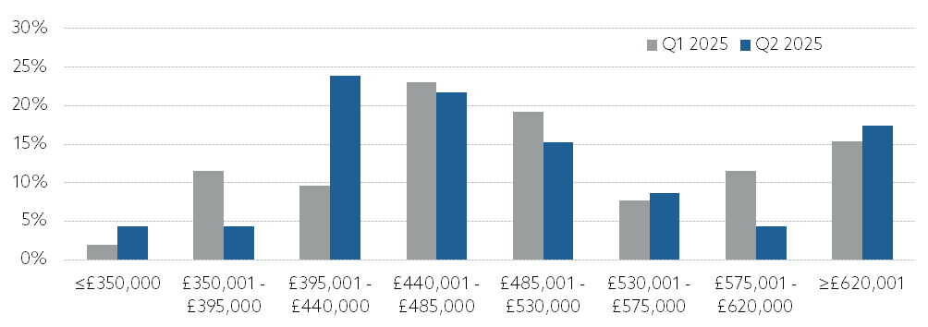
2-bedroom flats
House Price Index – Q2 2025
mean price of £514,000
essentially unchanged compared with the previous quarter
median price of £475,000

Slide 8
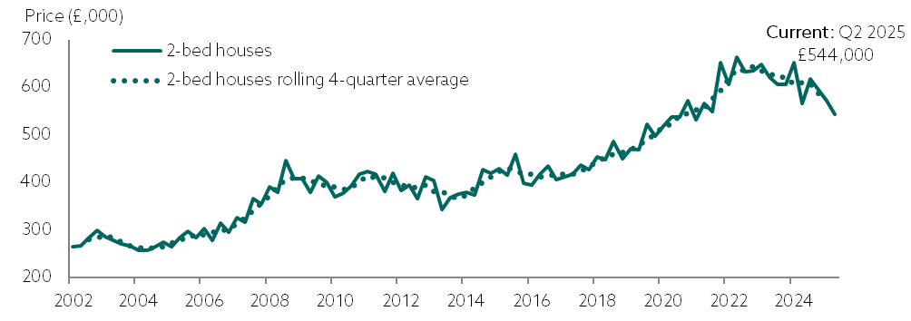
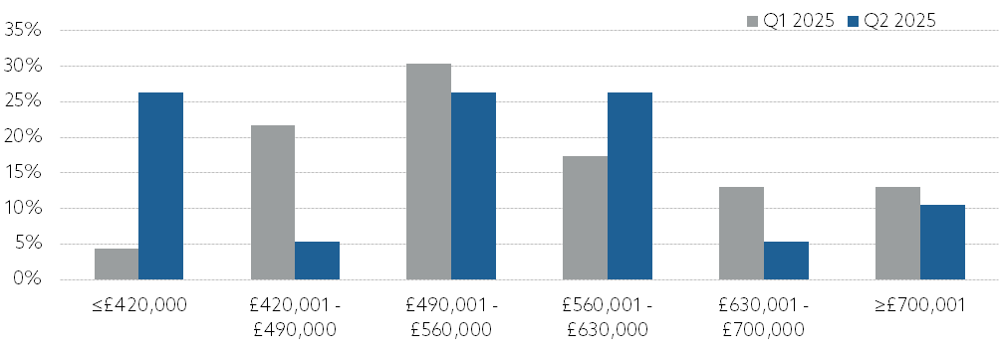
2-bedroom houses
House Price Index – Q2 2025
mean price of £544,000
27,000 decrease compared with the previous quarter
median price of £555,000

Slide 9
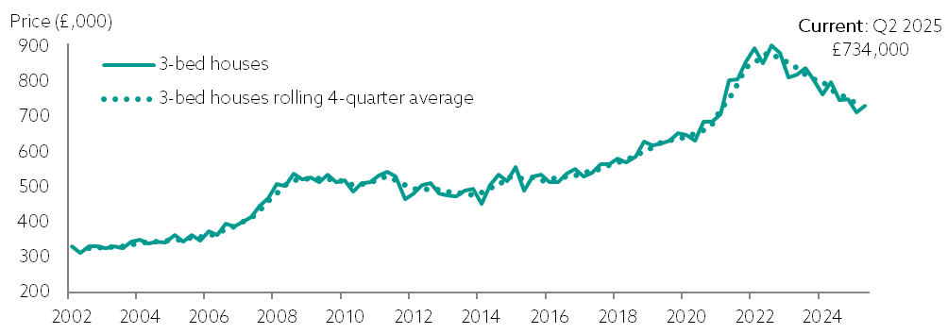
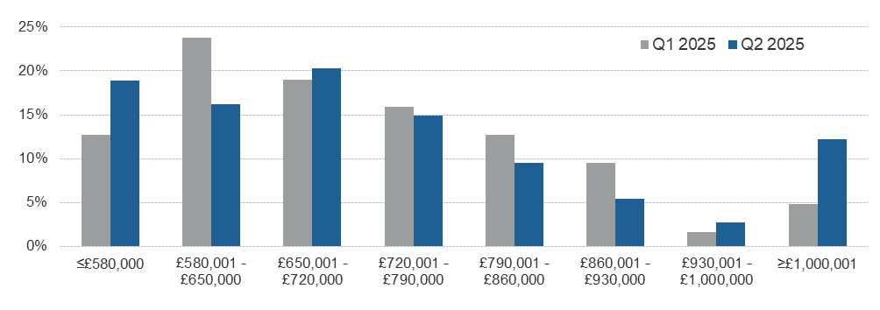
3-bedroom houses
House Price Index – Q2 2025
mean price of £734,000
18,000 increase compared with the previous quarter
median price of £705,000

Slide 10
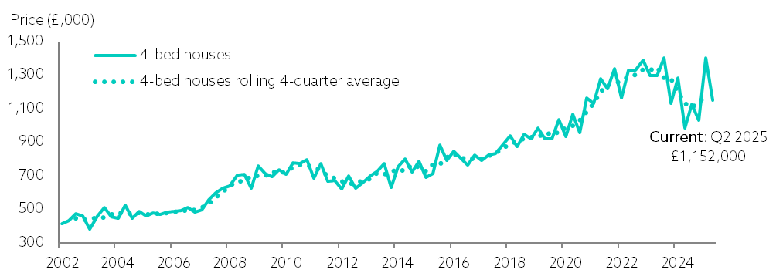
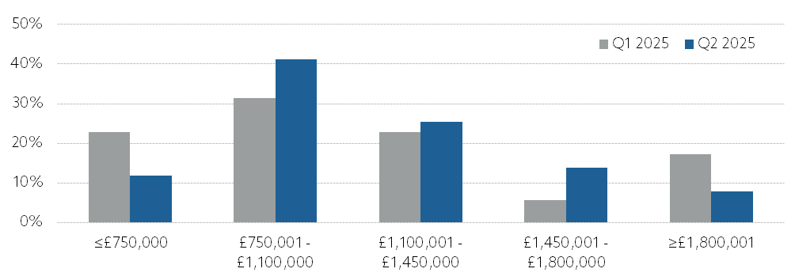
4-bedroom houses
House Price Index – Q2 2025
mean price of £1,152,000
253,000 decrease compared with the previous quarter
in the prior quarter there was a larger than usual number of very high value (more than £3,000,000) homes sold for this property type
median price of £1,085,000

Slide 11
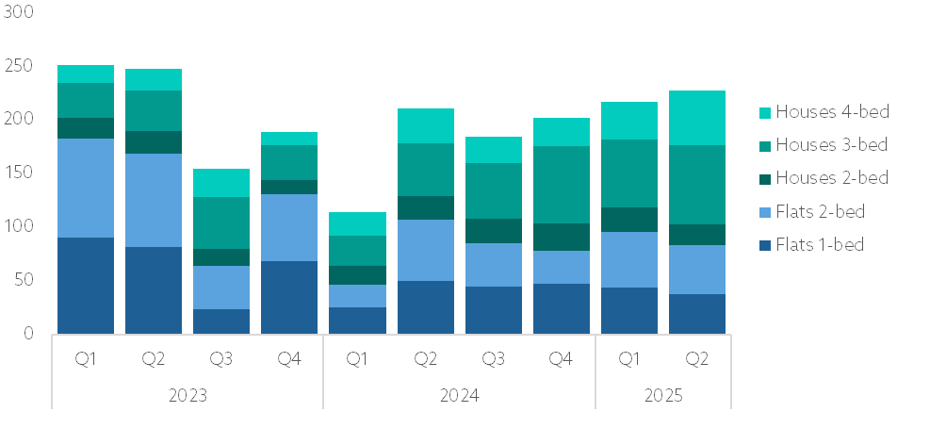
Turnover
House Price Index – Q2 2025
In the second quarter of 2025 turnover was:
8% higher than in Q2 2024, corresponding to 17 additional properties sold
5% higher than in Q1 2025, corresponding to 11 additional properties sold

Slide 12
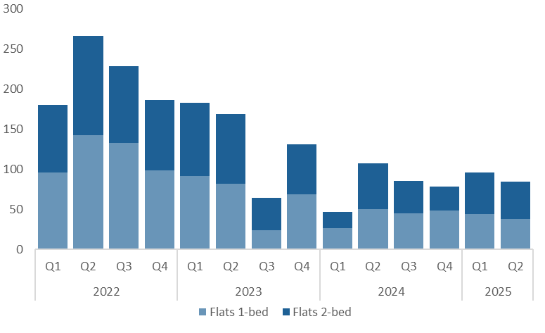
Turnover - Flats
House Price Index – Q2 2025
In Q2 2025 turnover of flats was 21% lower (23 fewer transactions) than in Q2 2024

Slide 13
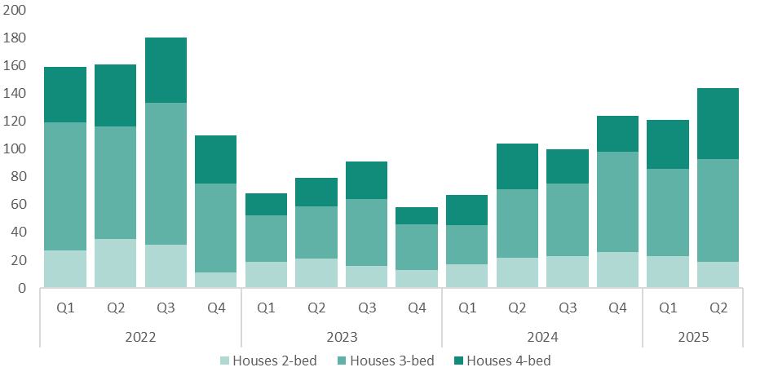
Turnover - Houses
House Price Index – Q2 2025
In Q2 2025 turnover of houses was 38% higher (40 additional transactions) than in Q2 2024

Slide 14
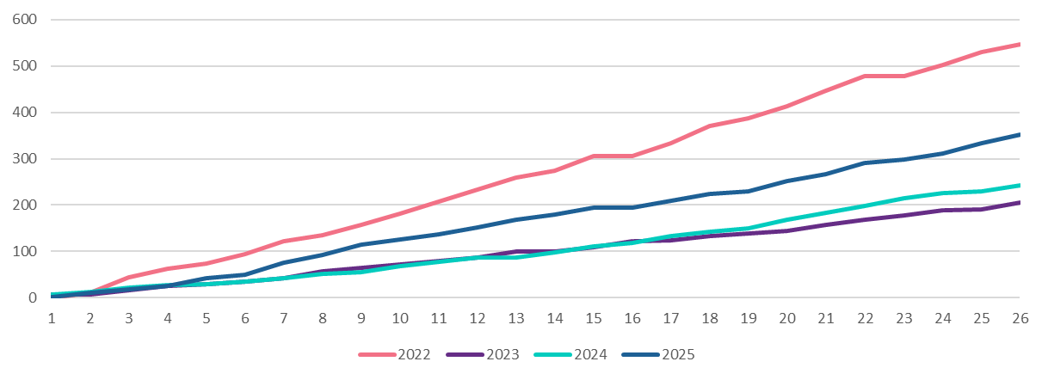
Royal Court turnover
House Price Index – Q2 2025
So far in 2025 Royal Court turnover has been significantly higher than in 2023 and 2024 but was still below historic levels.

Slide 15
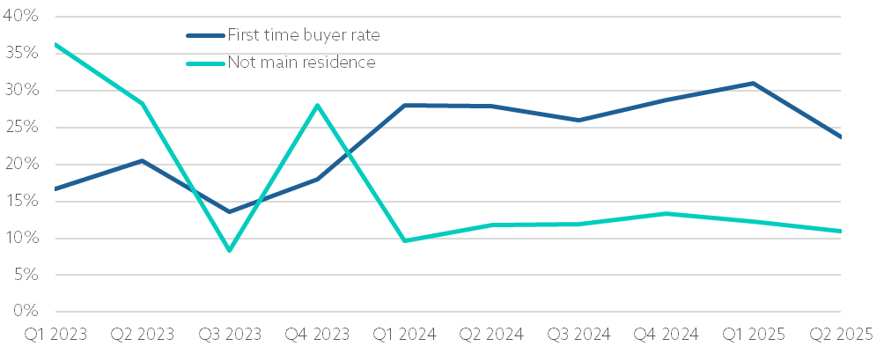
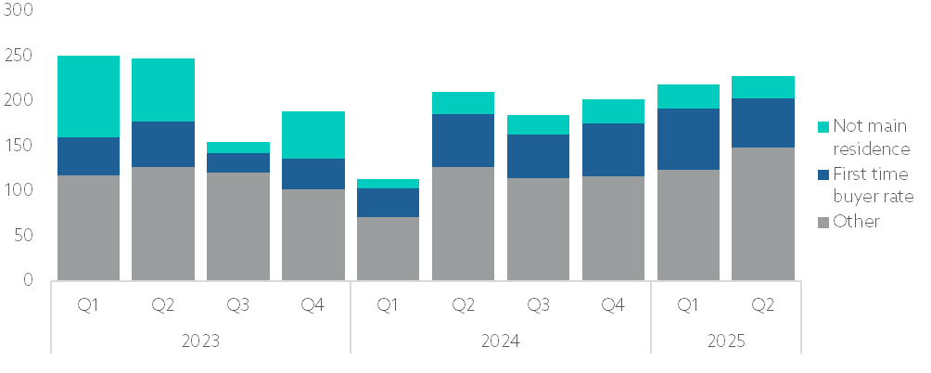
Quarterly composition of market sales
House Price Index – Q2 2025
In Q2 2025, around 30 properties purchased were not intended as the main residence for the buyers.
Meanwhile, first-time buyers bought around 50 properties.

Slide 16
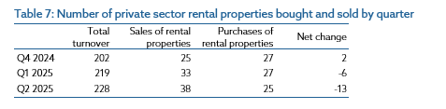
Sales in the private rental market
House Price Index – Q2 2025
Property transactions in the period Q4 2024 to Q2 2025 resulted in a slight decrease of 21 private rental units.
At the time of the 2021 census there were 10,739 occupied qualified private rental units, meaning a reduction of 21 private rental units represents around a 0.2% decrease in the rental market.
However, these transactions correspond to an increase of 21 owner-occupier households in Jersey, so the proportion of owner-occupied households would increase slightly by around 0.1% due to this.

Slide 17
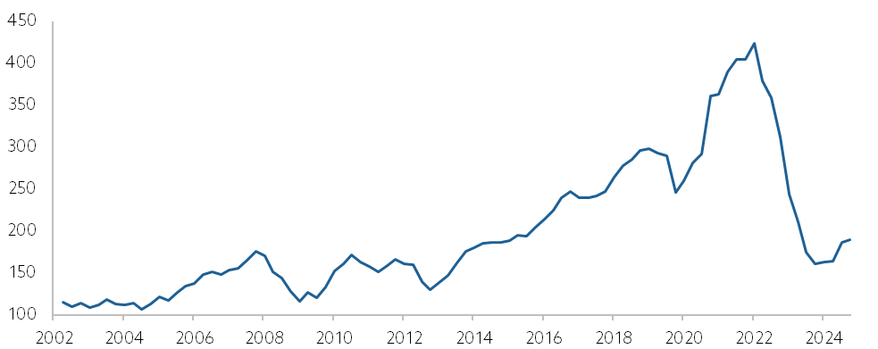
Housing market activity index
House Price Index – Q2 2025
Rolling four-quarter basis:
18% higher than in Q2 2024
2% higher than in Q1 2025
Quarterly basis:
7% higher than in Q2 2024
5% higher than in Q1 2025

Slide 18
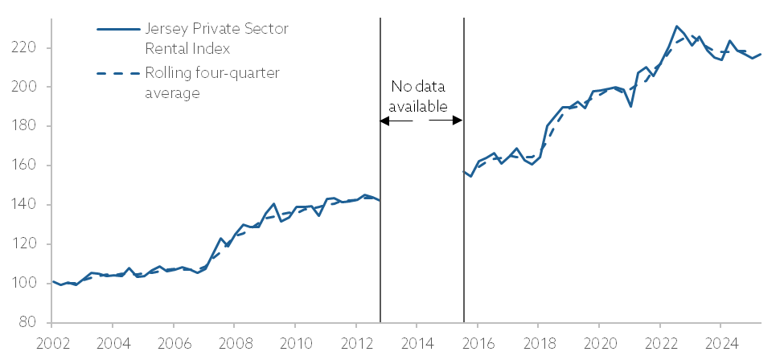
Private sector Rental Index
House Price Index – Q2 2025
Rolling four-quarter basis:
essentially unchanged compared with Q2 2024
Quarterly basis:
3% lower than in Q2 2024

Slide 19
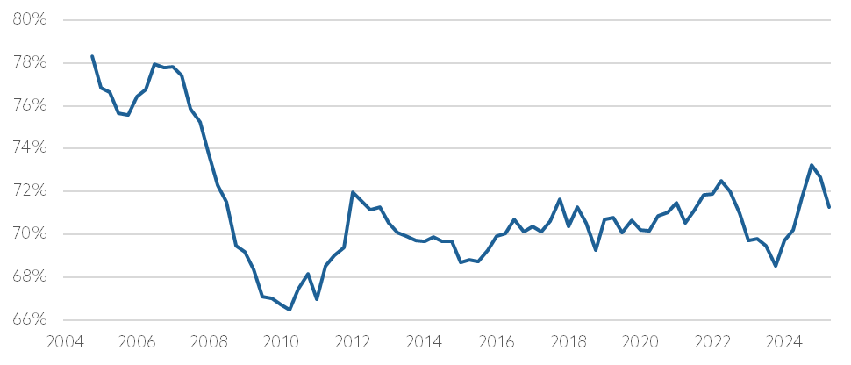
Loan to value
House Price Index – Q2 2025
the loan to value ratio of Royal Court transactions decreased this quarter

Slide 20
