Slide 1

House Price Index
Q3 2026
05 November 2026

Slide 2

Summary
House Price Index – Q3 2026
In the third quarter of 2026:
on an annual basis, the mix-adjusted average price of dwellings sold in Jersey in Q3 2026 was essentially unchanged when compared with the previous quarter (year ending Q2 2026)
the HPI was 13% lower than the peak in the index seen in Q3 2022
the turnover of properties was:
  6% lower than in Q3 2025
  4% lower than in the previous quarter (Q2 2026)

Slide 3
Summary
House Price Index – Q3 2026
In the third quarter of 2026:
of the HPI eligible properties transacted this quarter:
  37 were previously private rental properties
  27 were purchased to be private rental properties
this results in a net change of -10 units of private rental accommodation (essentially unchanged in private rental accommodation)

Slide 4
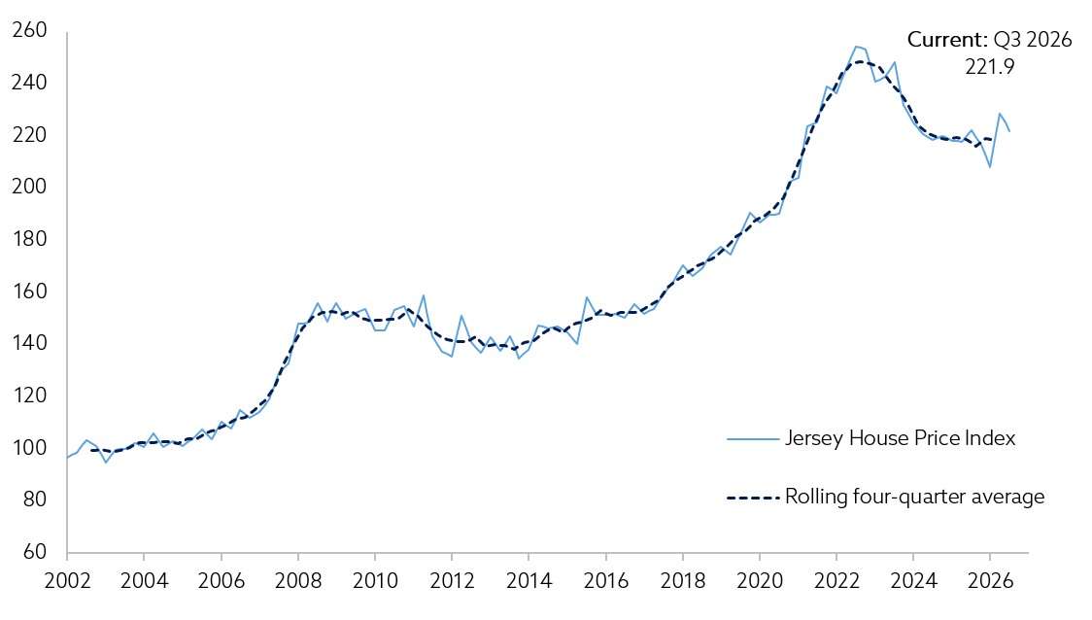
Mix-adjusted House Price Index
House Price Index – Q3 2026
Rolling four-quarter basis:
Essentially unchanged than in the previous quarter (Q2 2026)
Essentially unchanged when compared with a year earlier

Slide 5
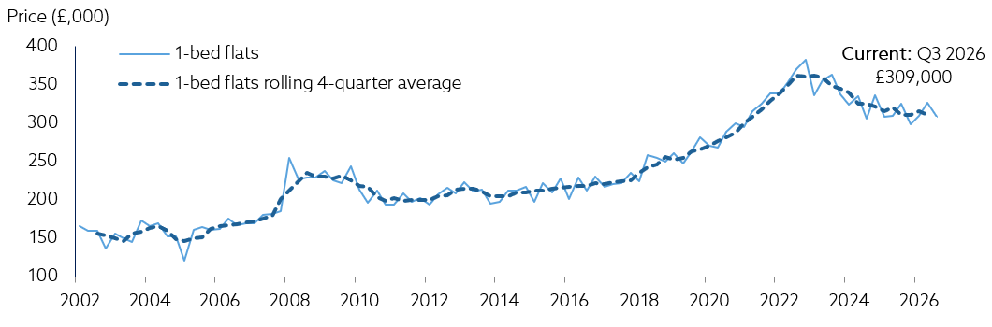
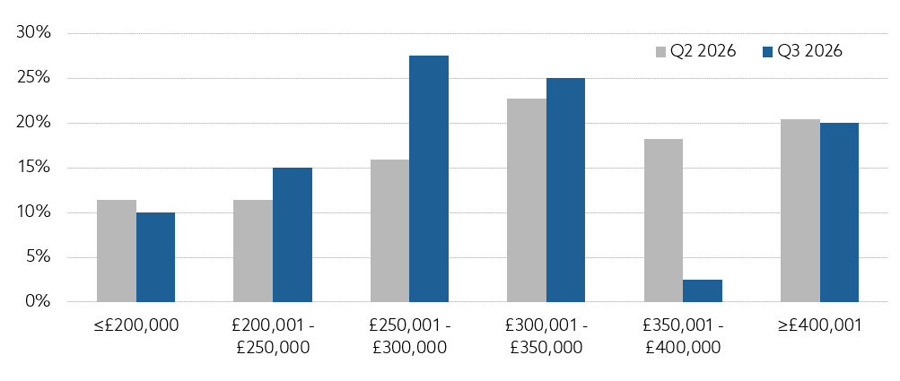
1-bedroom flats
House Price Index – Q3 2026
mean price of £309,000
£17,000 lower than previous quarter
median price of £297,000
around £50,000 lower than its rolling 4-quarter peak

Slide 6
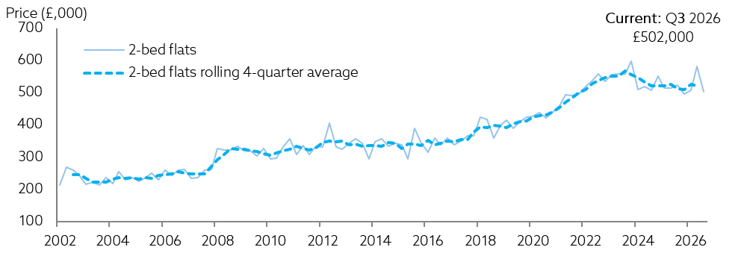
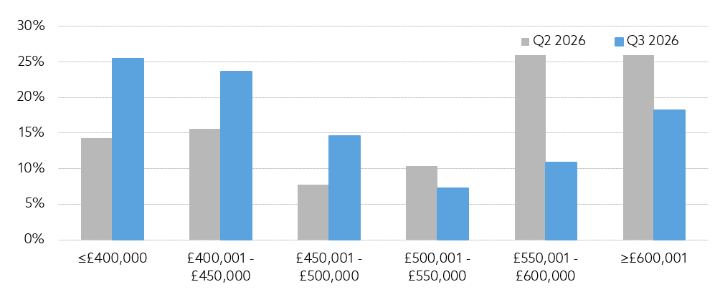
2-bedroom flats
House Price Index – Q3 2026
mean price of £502,000
£78,000 decrease compared with the previous quarter
median price of £465,000
around £50,000 lower than its rolling 4-quarter peak

Slide 7
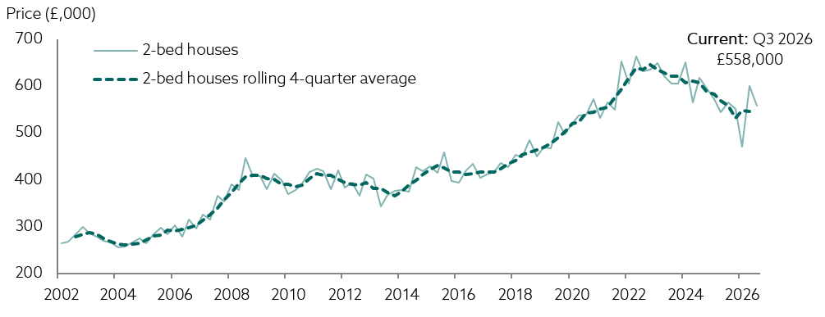
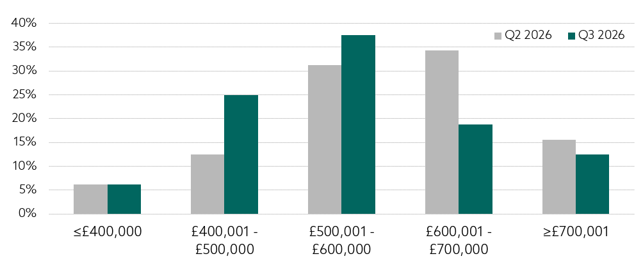
2-bedroom houses
House Price Index – Q3 2026
mean price of £558,000
£43,000 decrease compared with the previous quarter
median price of £560,000

Slide 8
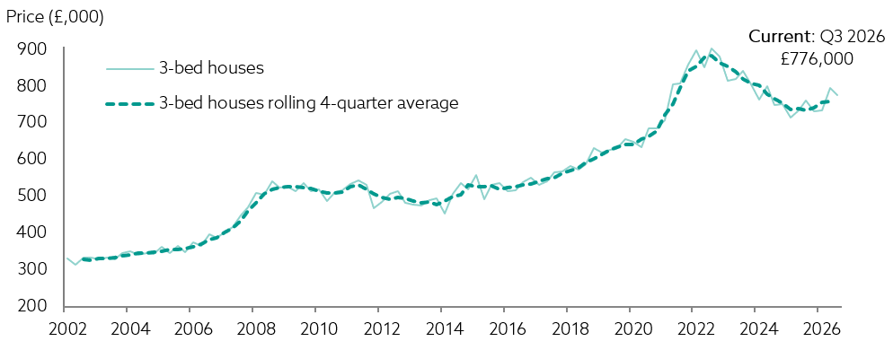
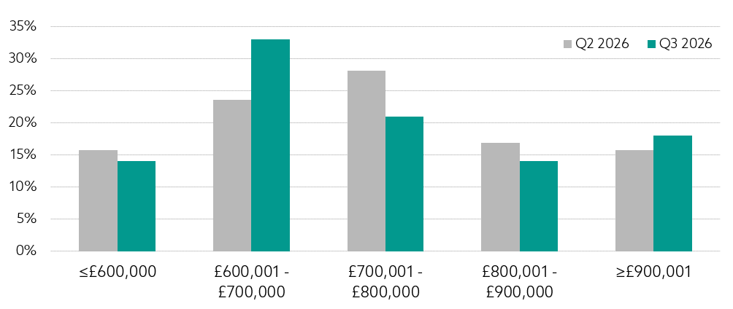
3-bedroom houses
House Price Index – Q3 2026
mean price of £776,000
£21,000 decrease compared with the previous quarter
median price of £709,000
around £120,000 lower than its rolling 4-quarter peak

Slide 9
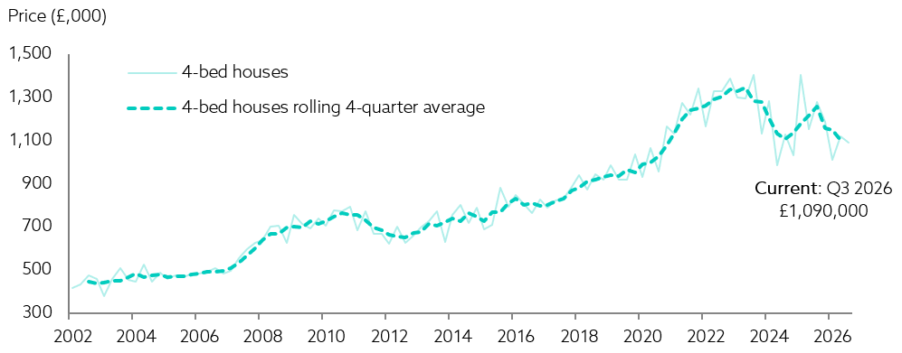
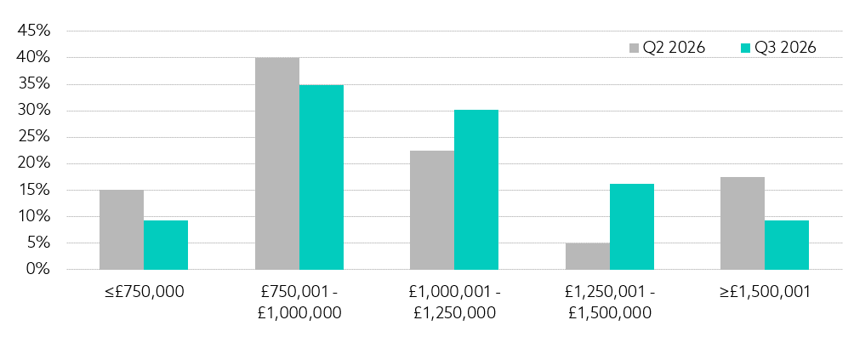
4-bedroom houses
House Price Index – Q3 2026
mean price of £1,090,000
£32,000 lower compared with the previous quarter
median price of £1,050,000

Slide 10
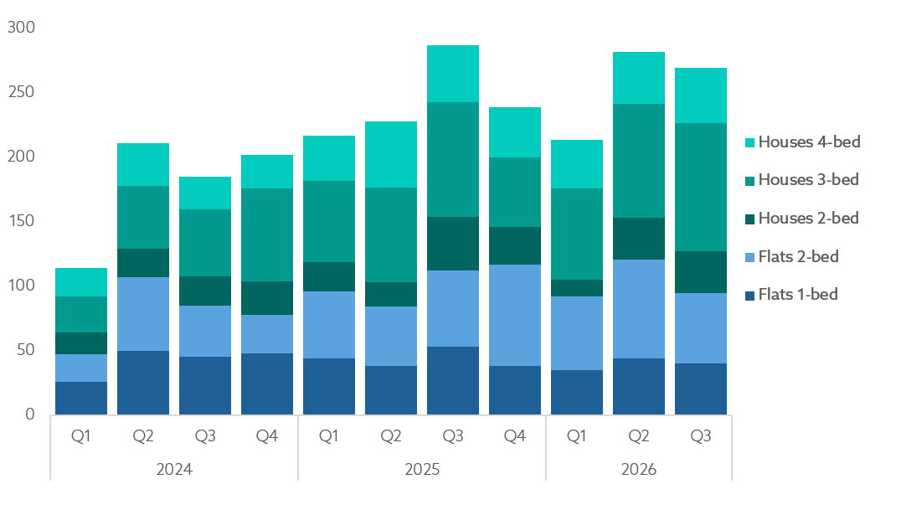
Turnover
House Price Index – Q3 2026
In the third quarter of 2026, turnover was:
6% lower than in Q3 2025, corresponding to 17 fewer properties sold
4% lower than in Q2 2026, corresponding to 12 fewer properties sold

Slide 11
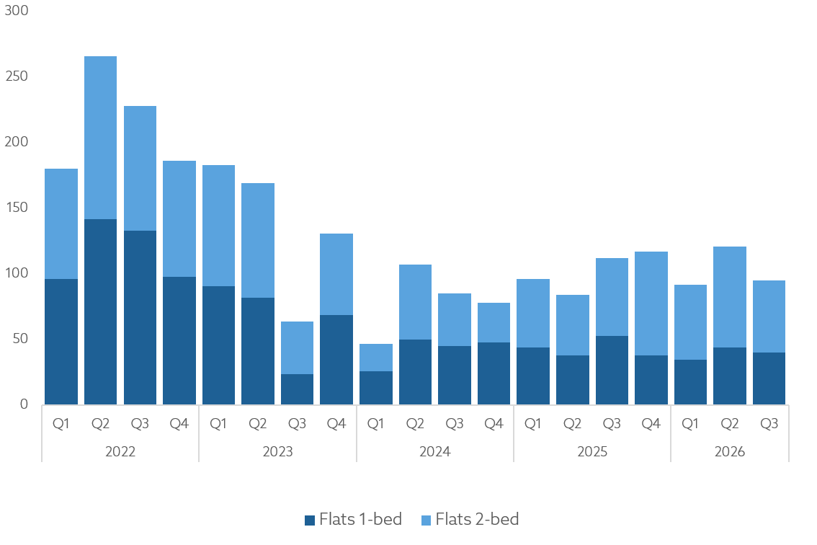
Turnover - Flats
House Price Index – Q3 2026
In Q3 2026 turnover of flats was 15% less than in Q3 2025
(17 less transactions)

Slide 12
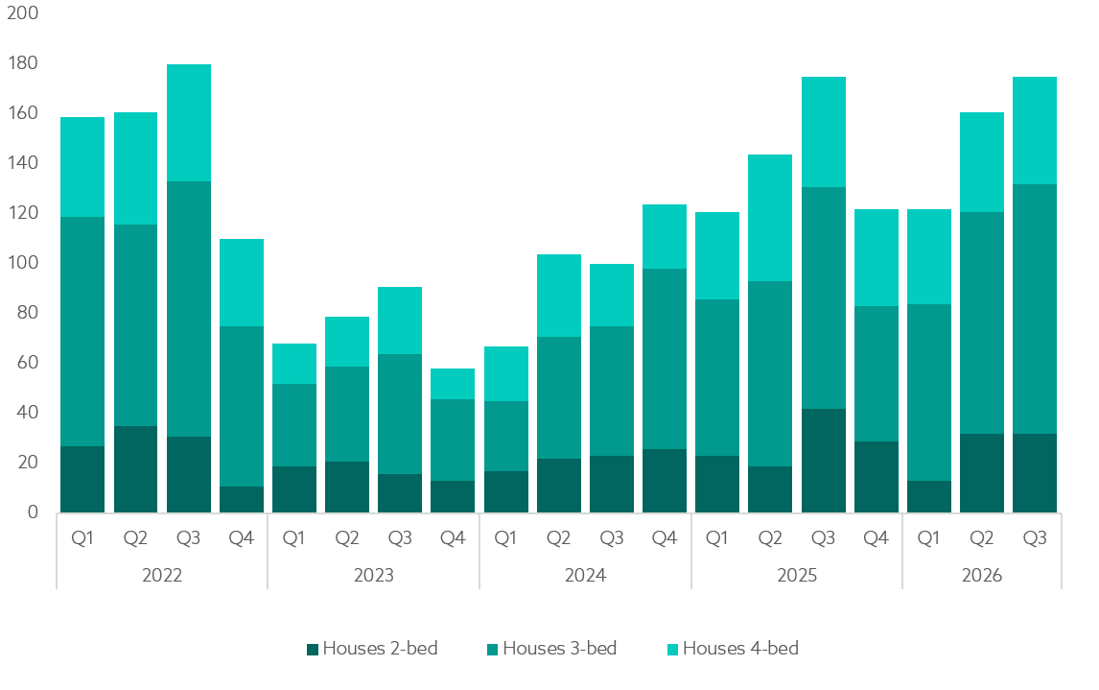
Turnover - Houses
House Price Index – Q3 2026
In Q3 2026 turnover of houses was the same as Q3 2025
(no change in transactions)

Slide 13
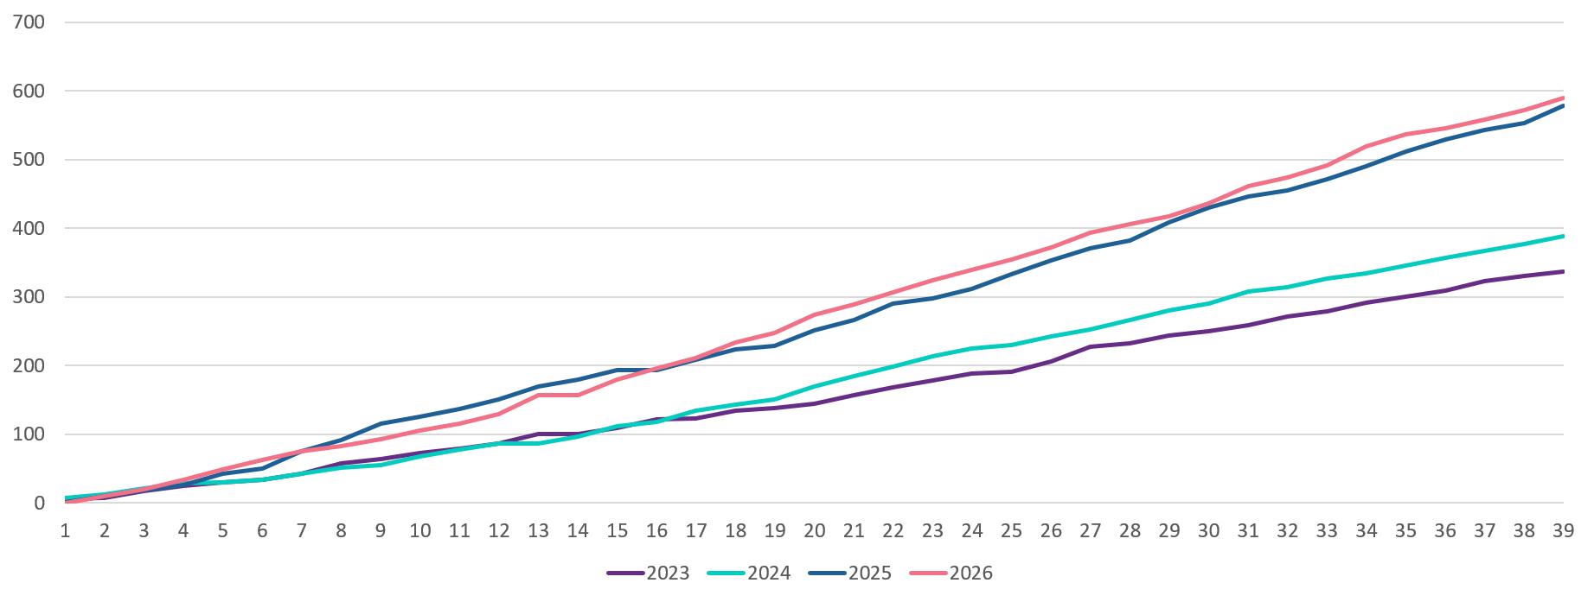
Royal Court turnover
House Price Index – Q3 2026
So far in 2026 Royal Court turnover has been significantly higher than in 2023 and 2024, and slightly higher than 2025 levels.

Slide 14
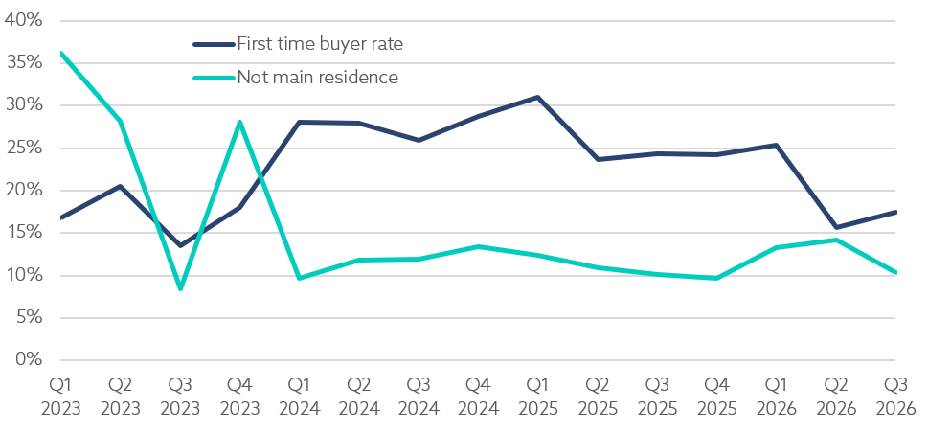
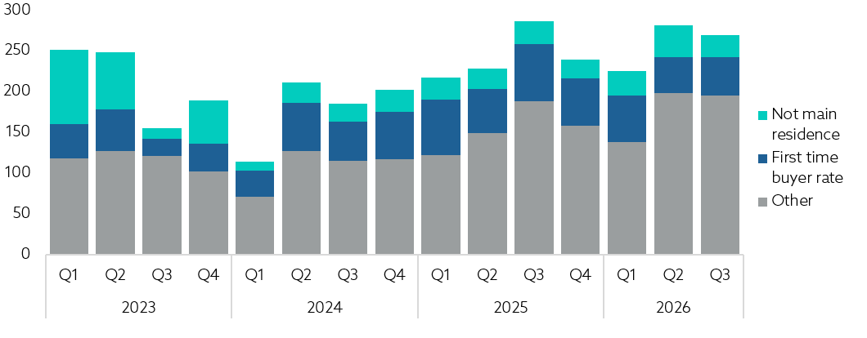
Quarterly composition of market sales
House Price Index – Q3 2026
In Q3 2026, around 30 properties purchased were not intended as the main residence for the buyers.
Meanwhile, first-time buyers bought around 50 properties, an increase of 10 from Q2 2026

Slide 15
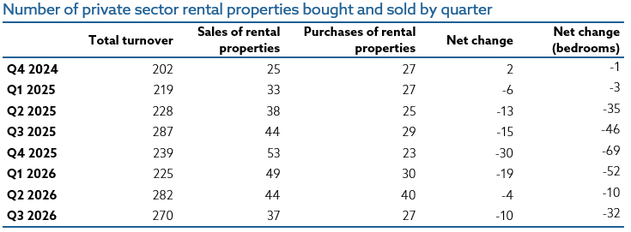
Sales in the private rental market
House Price Index – Q3 2026
Property transactions in the 12-month period Q4 2025 to Q3 2026 resulted in a decrease of 63 private rental units.
At the time of the 2021 census there were 10,739 occupied qualified private rental units, meaning a reduction of 63 private rental units represents around a 0.6% decrease in the rental market.
However, these transactions correspond to an increase of 63 owner-occupier households in Jersey, so the proportion of owner-occupied households would increase slightly by around 0.4% due to this.

Slide 16
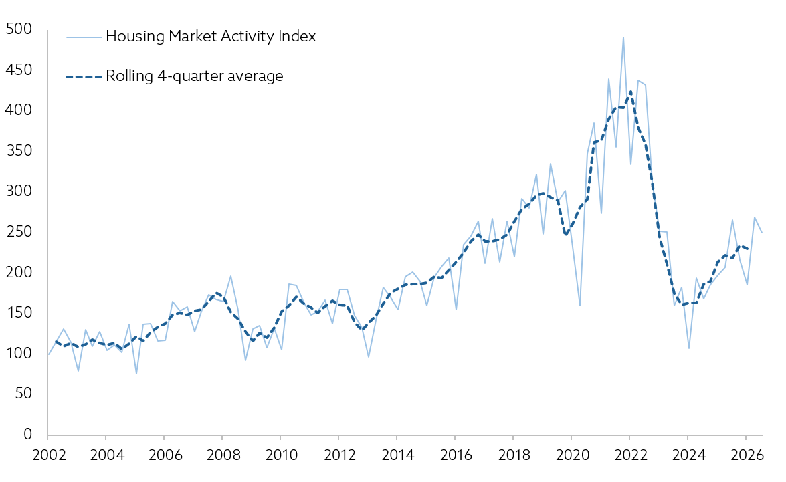
Housing market activity index
House Price Index – Q3 2026
Rolling four-quarter basis:
2% lower than in Q2 2026
8% higher than in Q3 2025
Quarterly basis:
7% lower than in Q2 2026
6% lower than in Q3 2025

Slide 17
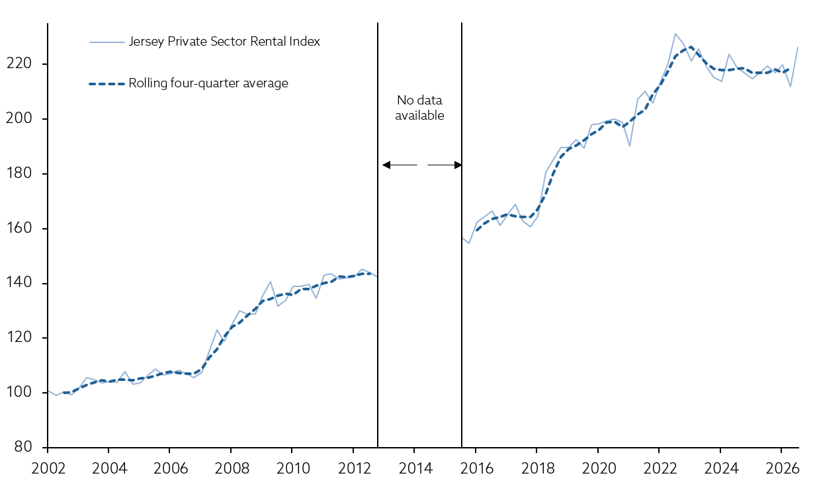
Private sector Rental Index
House Price Index – Q3 2026
Rolling four-quarter basis:
1% higher compared
with Q3 2025
Quarterly basis:
3% higher compared
with Q3 2025

Slide 18
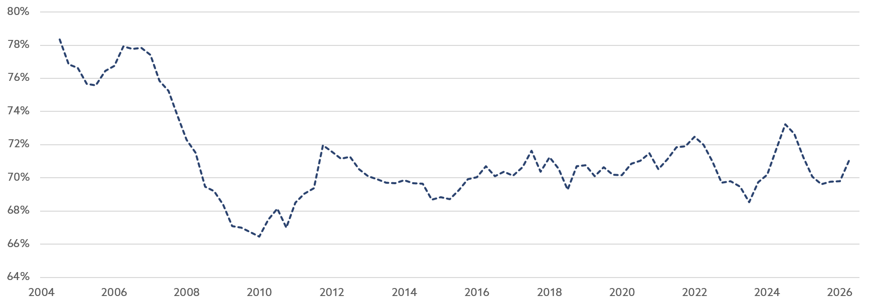
Loan to value
House Price Index – Q3 2026
The rolling 4-quarter average loan to value ratio of Royal Court transactions was 1% higher when compared with the year ending Q3 2025

Slide 19
